Slide 1
Well come
to
Our presentation

Slide 2
Group members name
Disha Sonani
Yashasavi borda
Khusboo gajera
Vanita Baraiya
Bhakti meroliya
Isha sutariya

Slide 3
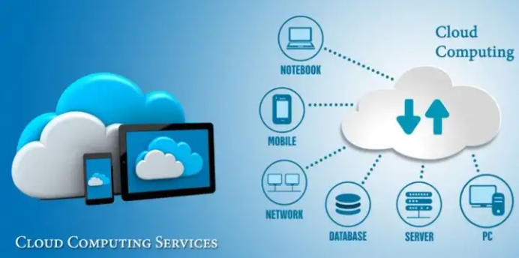
Cloud computing
Disha Sonani

Slide 4
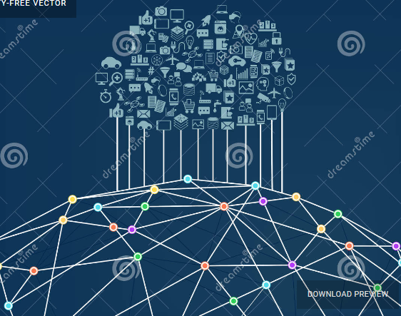
INTRODUCTION :
cloud computing provides us a mean by which we can access the applications as utilities over the internet. it allows us to create configure and customize applications online
With cloud computing users can access database resources via the internet from anywhere for as long as they need without worrying about any maintenance or management to actual resource.

Slide 5
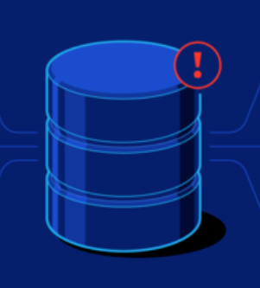
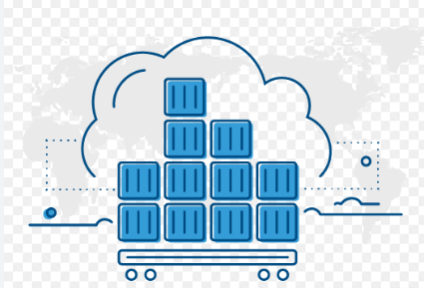
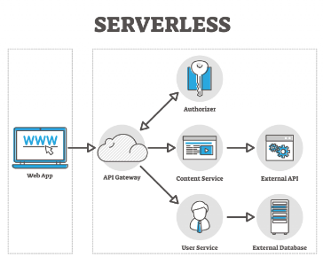
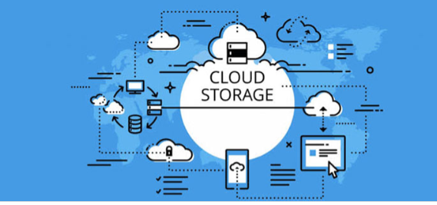
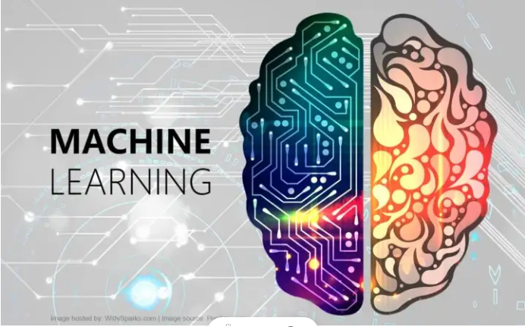
Cloud computing divide 5 parts :
1. Data base
2. Containers
5.serverless
3. Machine learning
4. storage

Slide 6
What is cloud ?
The term cloud refers to a NETWORK or INTERNET. In others words we can say that cloud is something which is present at remote location.
Cloud can provide services over network i.e. on public network or on private network i.e. WAN, LAN, CAN.
Applications such as e-mail, web conferencing, customer relationship management(CRM) all run is cloud.

Slide 7
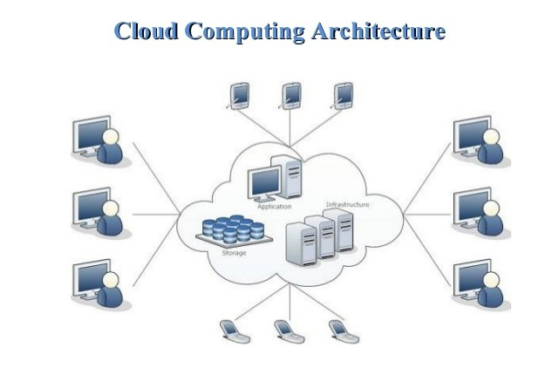
Cloud computing
Cloud computing refers to manipulating configuring and accessing the application online. It offers online data storage, infrastructure and applications.
Cloud computing is both a combination of software and hardware based computing resource delivered as a network service

Slide 8
ADVANTAGES AND DISADVANTAGES
ADVANTAGES
DISADVANTAGES
1. Data security
2. Back up and store data
3. Improved collaboration
4. Excellent accessibility
5. Low maintenance cost
6. Mobility
7. Unlimited storage capacity
8. Data security
1. Internet Connectivity
2. Limited Control
3. Security
4. Vendor lock-in
back

Slide 9
DATA BASE
Yashasvi Borda

Slide 10
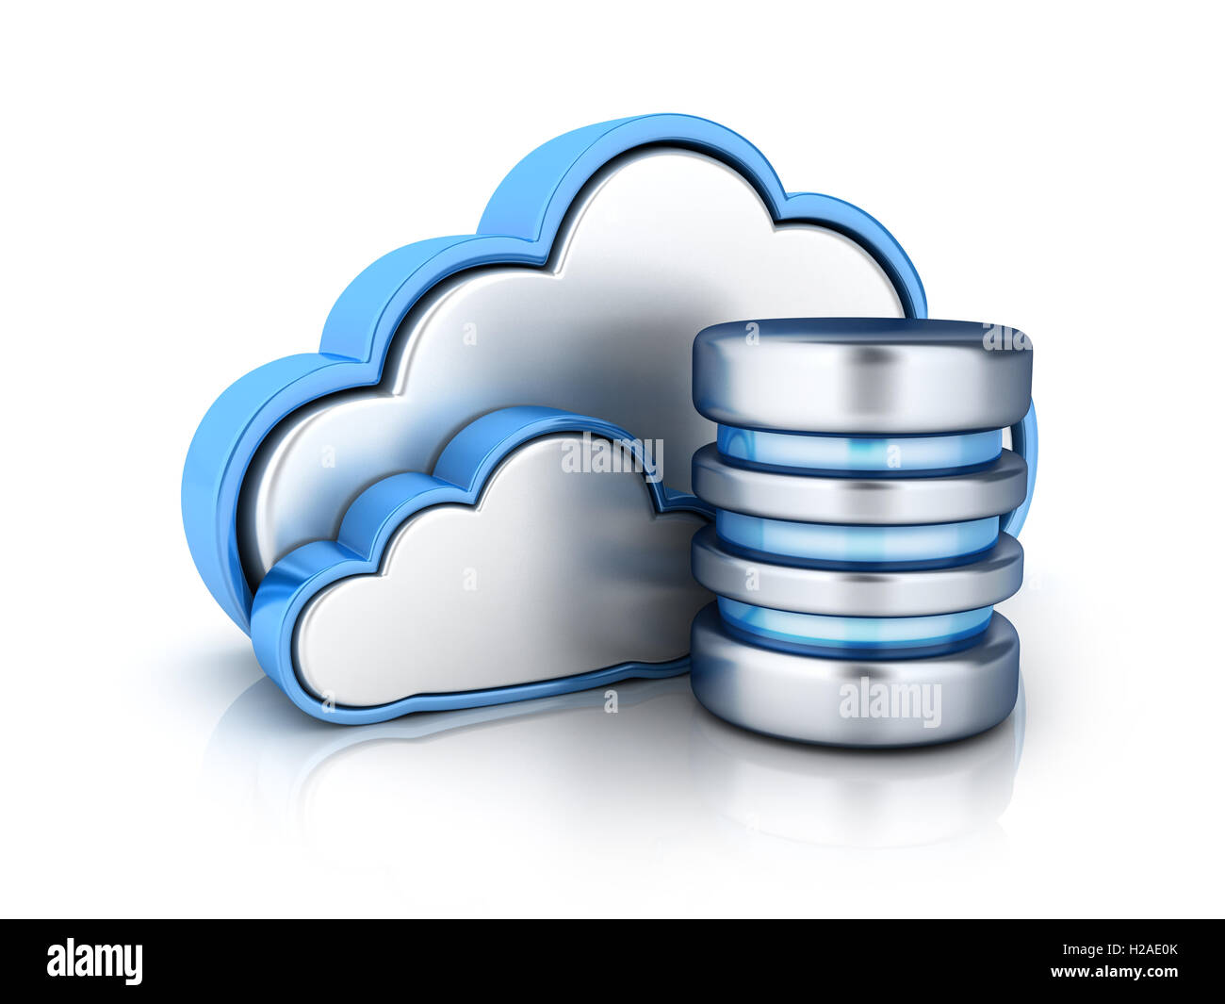
DATA BASE
A cloud database is a database that typically runs on a cloud computing platform, access to it is provided as a service such as Amazon EC2 and Rack space
The cloud databases was conceived for the purpose of online data management by using a variety of distributed servers

Slide 11
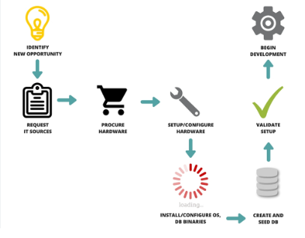
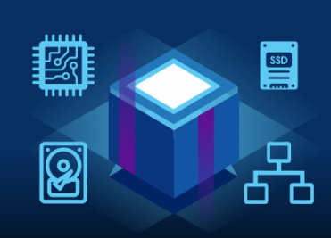
Methods to run a databases in a cloud :
There are two primary methods to run a databases in a cloud:
1) Virtual machine image
2) Databases-as-a-service

Slide 12
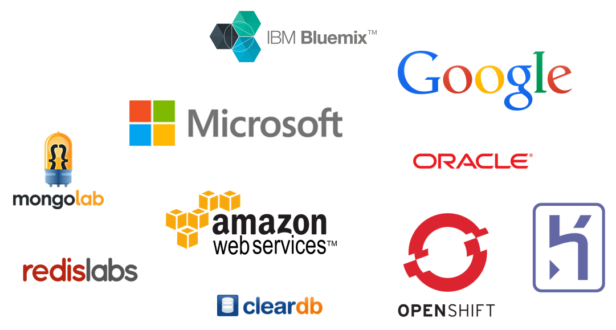
1) Virtual machine image
Cloud platforms allow users to purchase virtual-machine instances for a limited time and one can run a databases on such virtual machines.
2) Databases-as-a-service
With a databases as a service model application owners do not have to install and maintain the databases themselves.

Slide 13
ADVANTAGES AND DISADVANTAGES
Advantages
DISADVANTAGES
Database eliminates the redundancy of data by integrating them
. 2. Data consistency is increased
3. Additional information can be derived from same data
Complex software
2. It requires more memory
3. Multiuser DBMS can be more expensive
back

Slide 14
Cloud containers :
Khushbu gajera

Slide 15
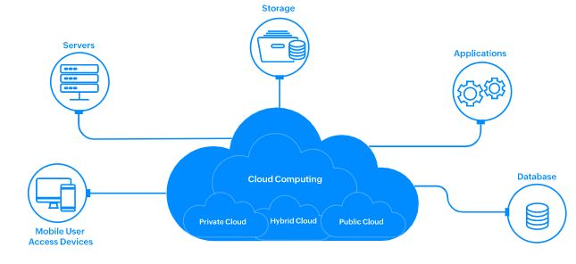
What is containers :
Containers are packages of software that contain all of the necessary elements to run in any environment. In this way, containers virtualize the operating system and run anywhere, from a private data center to the public cloud or even on a developer’s personal laptop.
Containers are two parts of devide :
1. The classic case for a container
2. Emergence of containers

Slide 16
1. The classic case for a container
Containers help resolve a typical dilemma faced by many developers in the evolving native-cloud based application opportunity, – varying computing environments meant that an application tested using Python 2.x could face issues because the production environment ran on Python 3.x ---- or ---- the application is tested on a certain Secure Socket Layer / SSL library, while the production environment has another one installed. Additionally, variations in security settings, file storage setup and network setups could cause the application to fail.
2. Emergence of containers
To allow applications, like microservices, to operate across computing environments, the concept of the containers emerged. While virtual machines (VMs) were in use before containers, VMs for microservices were bulkier due to OS images in the VM. A container is a logical packaging of the application, isolating it from the environment in which it runs. This allows container-based applications to be deployed with ease, regardless of the target environment which could be a private data center, the public cloud, or even a personal computer.

Slide 17
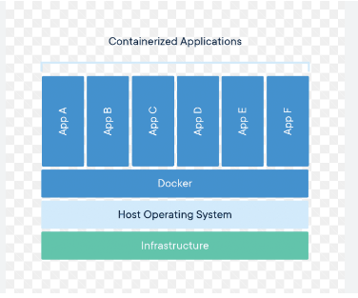
Containers diagram :

Slide 18
Benefits of containers :
Application isolation
Containers virtualize CPU, memory, storage, and network resources at the operating system level, providing developers with a view of the OS logically isolated from other applications.
Workload portability
Containers can run virtually anywhere, greatly easing development and deployment: on Linux, Windows, and Mac operating systems; on virtual machines or on physical servers; on a developer’s machine or in data centers on-premises; and of course, in the public cloud.
Separation of responsibility
Containerization provides a clear separation of responsibility, as developers focus on application logic and dependencies, while IT operations teams can focus on deployment and management instead of application details such as specific software versions and configurations.

Slide 19
ADVANTAGES AND DISADVANTAGES :
ADVANTAGES :
DISADVANTAGES :
1. Higher Scalability
2. Pipeline Management
3. Increased Productivity
4. Process Isolation
1 . Risks of using containers
2. Security limitations
3. Development difficulties
4. Increased expenses
back

Slide 20
Machine learning
Vanita baraiya

Slide 21
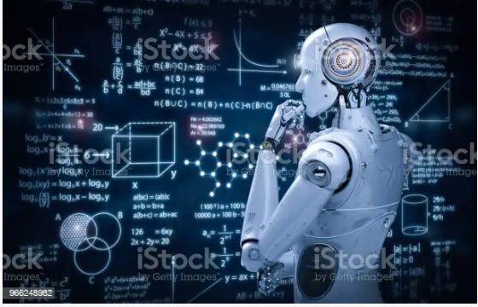
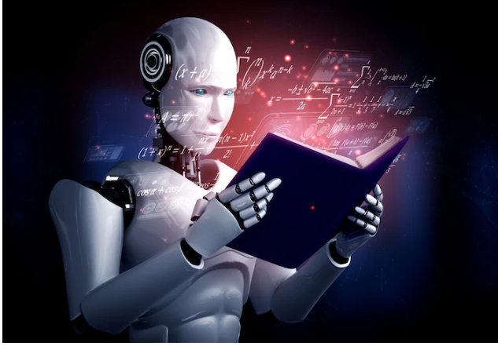
M A C H I N E
L E A R N I N G :
Machine learning is an application of artificial intelligence that intelligence that involves algorithms and data automatically analyse and make decision by itself without human intervention
It describes how computer perform tasks on their own by previous experiences.
Therefore we can say in machine language artificial intelligence is generated on the basis of experience.

Slide 22
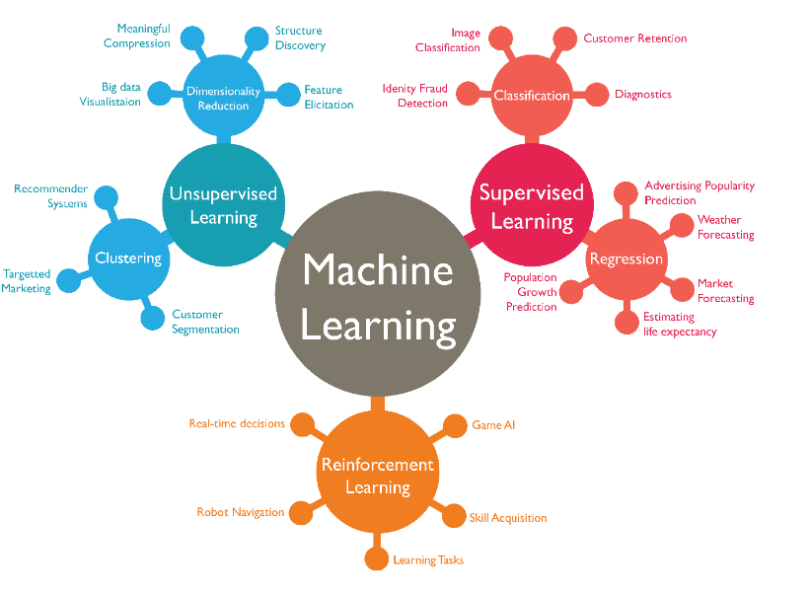

Slide 23
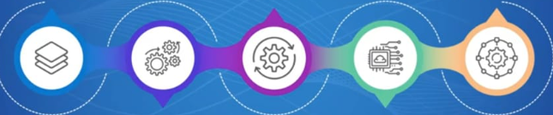
Easily identifies trends and patterns :
3. Continuous improvement
5. Wide applications
As ML algorithms gain experience they keep improving in accuracy and efficiency. This lets them make better decisions
You could be an e-tailer or a healthcare provider and make ML works for you. Where it does apply. It holds the capability to help deliver a much more personal experience to customers while also targeting right customers
Machine learning can review large volumes of data and discover specific trends and pattens that would not be apparent to humans
ADVANTAGES :
2. No human intervention needed :
4. Handling Multi Dimensional and multi variety data :
With ML you don’t need to babysit your project every step of the way. Since it means giving machines the ability to learn, it lets them make predications and also improves the algorithms on their own
Machine learning algorithms are good at handling data that are Multidimensional and multi- variety can do this in in dynamic or uncertain environment

Slide 24
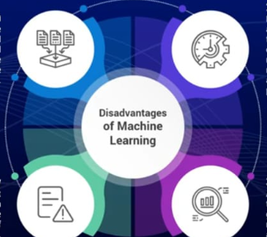
DISADVANTAGES :
1. Data Acquisition :
2. Time and Resources :
Machine learning requires massive data sets to train on and these should be inclusive/unbiased and of good quality. There can also be times where they must wait for new data to be generated.
ML needs enough time to let the algorithms learn and develop enough to fulfil their purpose with a considerable amount of accuracy and relevancy. It also needs massive resources to function. This can mean additional requirements of computer power for you.
3. High Error susceptibility :
4. Interpretation of results:
Machine learning is autonomous but highly susceptible to errors. And when they do get noticed.
It takes quite some time to recognize the source of the issues, and even to correct it.
Another major challenge is the ability to accurately interpret results generated by the algorithms. You must also carefully choose the algorithms for your purpose.

Slide 25
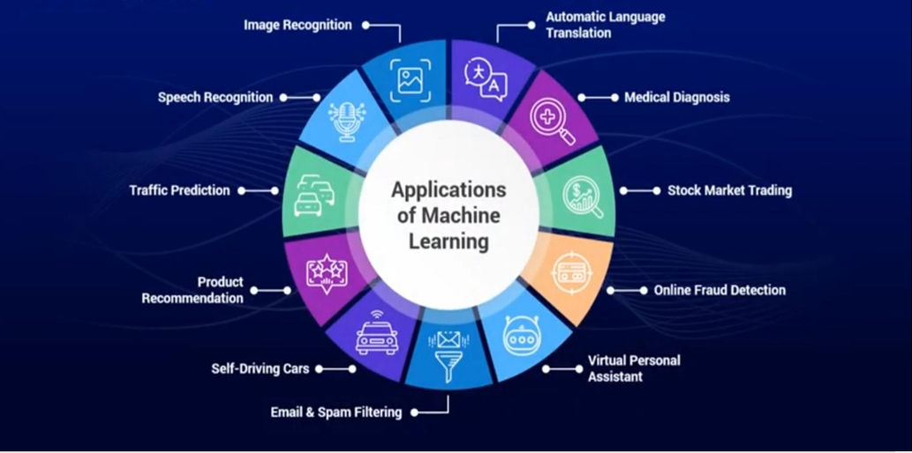
Machine learning Applications :
back

Slide 26
5. Storage
Bhakati meroliya

Slide 27
What is storage :
Storage is a process through which digital data is saved
within a data storage device by means of computing
technology. Storage is a mechanism that enables a
computer to retain data, either temporarily or
permanently.
2. Storage devices such as flash drives and hard disks are a
fundamental component of most digital devices since they
allow users to preserve all kinds of information such as videos,
documents, pictures and raw data.

Slide 28
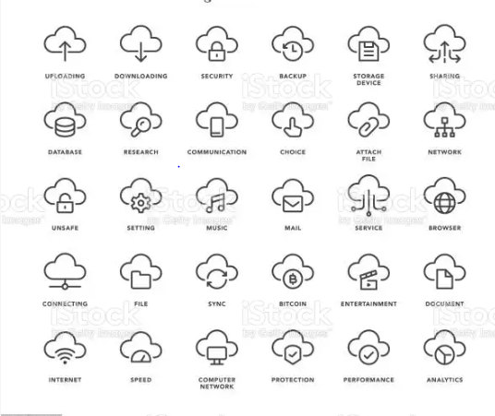
Cloud storage icons :

Slide 29
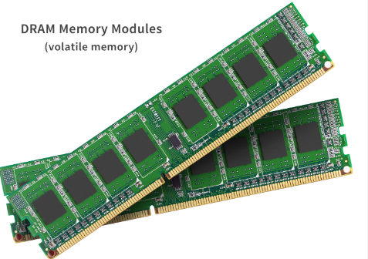
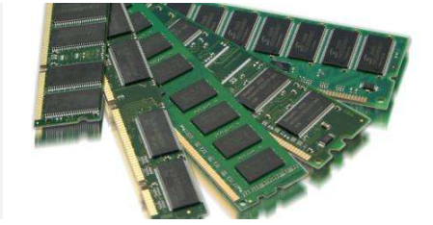
Storage are major two types :
Volatile memory
Non- volatile memory

Slide 30
Volatile memory :
Non- volatile memory :
Requires a continuous supply of electricity to store/retain data. It acts as a computer's primary storage for temporarily storing data and handling application workloads. Examples of non-volatile storage include cache memory and random access memory (RAM).
A type of storage mechanism that retains digital data even if it’s powered off or isn’t supplied with electrical power. This is often referred to as a secondary storage mechanism, and is used for permanent data storage requiring I/O operations. Examples of volatile storage include a hard disk, USB storage and optical media.

Slide 31
ADVANTAGES AND DISADVANTAGES :
ADVANTAGES :
DISADVANTAGES :
Cost
Accessibility
Recovery
Syncing and updating
security
Internet connection
Costs
Hard drives
Support
Privacy
back

Slide 32
SERVERLESS
isha

Slide 33
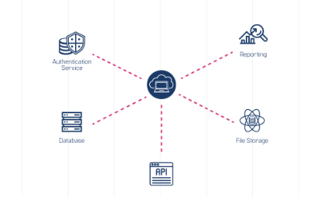
What is serverless ?
Serverless is a cloud-native development model that allows developers to build and run applications without having to manage servers.
2. Serverless of backend infrastructure completely.
3. Serverless function have a runtime in stateless container i.e. Node, JS, Java
script, go, python, java.
4. Micro-billing instead of per hours/month billing.

Slide 34
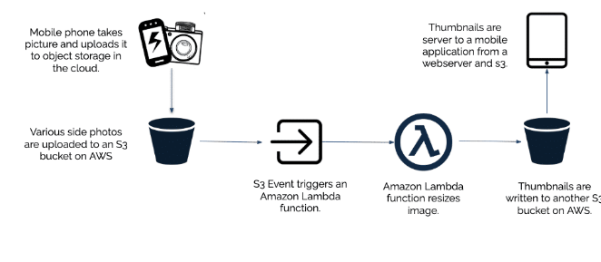
Serverless functions example

Slide 35
Benefits of serverless
Drawbacks of serverless
Effortless efficiency
Productivity boost
Cost-effective
Simplified operations
Debugging
Security
Vendor limitations
Response latency

Slide 36
S E R V E R V E R S U S S T O R A G E
SERVER
STORAGE
A Program or a hardware device that provides services to other devices in the network
Provides data, allows resource sharing and provides other services to client machines in the network
A physical device on a computer that is capable of storing data permanently
Used to store and access data, files and applications
back

